Slide 1
Barberton Greenstone Shale XRD Analysis
Aseem Rajopadhye, Ethan Edmans, Dr. Ariel Anbar
ASU School of Earth and Space Exploration

Slide 2
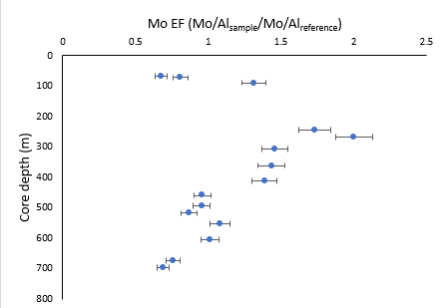
Compositional analysis of minerals present in 3.2-billion-year-old (Ga) shale samples from the Barberton Greenstone Belt using X-Ray Diffraction (XRD)
Project Overview

Slide 3
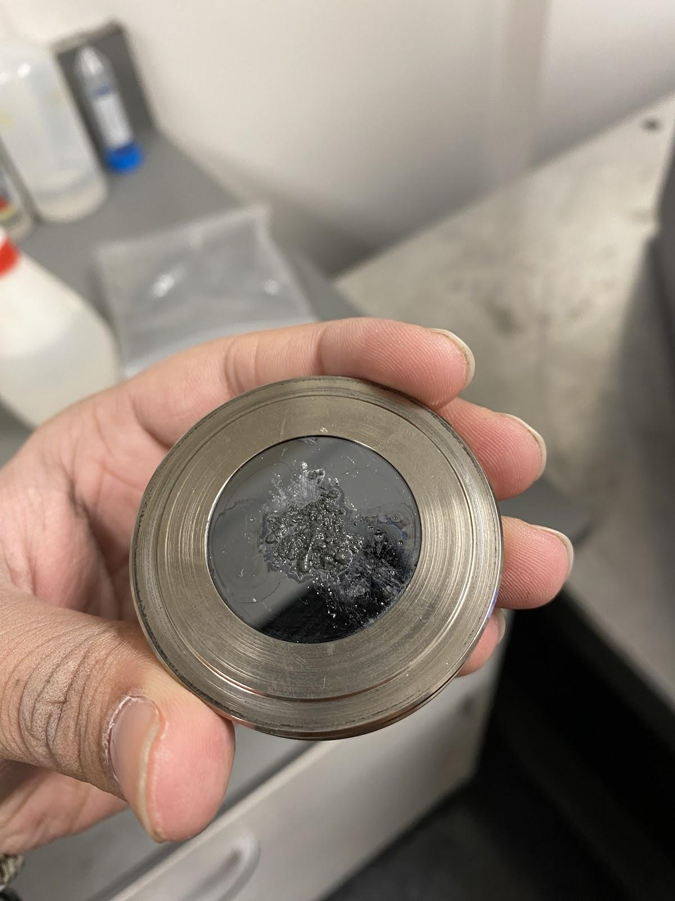
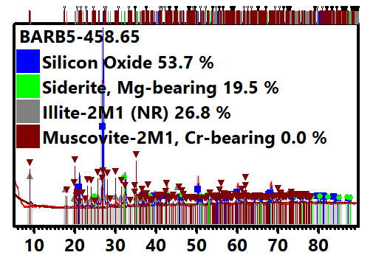
Procedure
PANalytical XRD Machine requires powder to be placed on slide, with isopropyl alcohol placed to spread (right).
XRD Graph produced (example below), analyzed in HighScore XRD Analysis Software

Slide 4
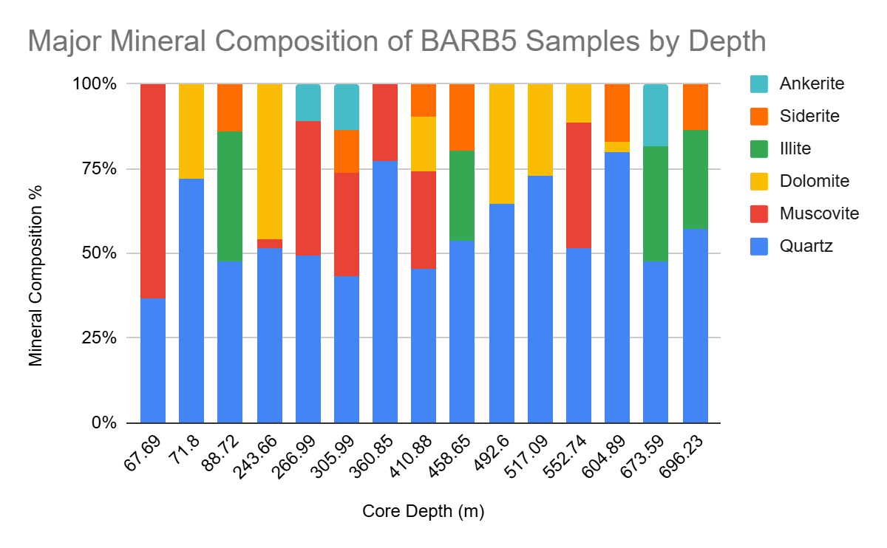
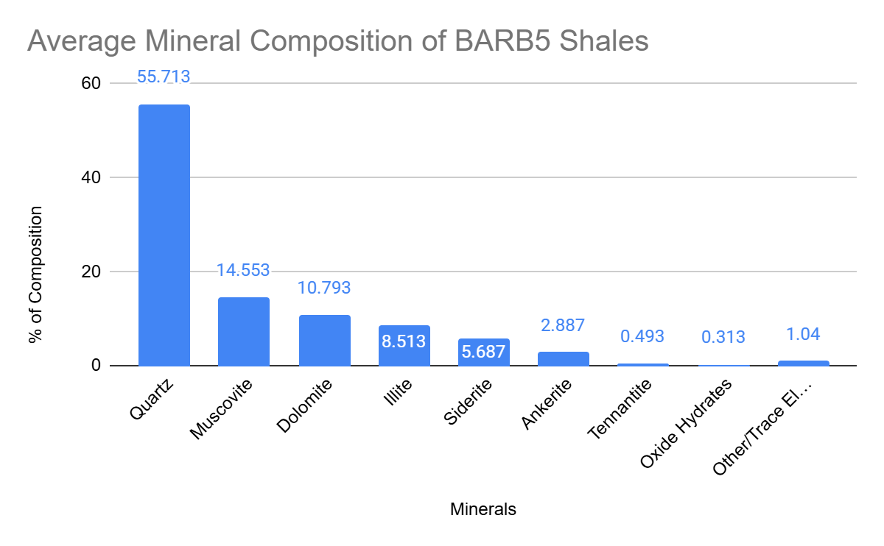
Results… What do They tell us?

Slide 6
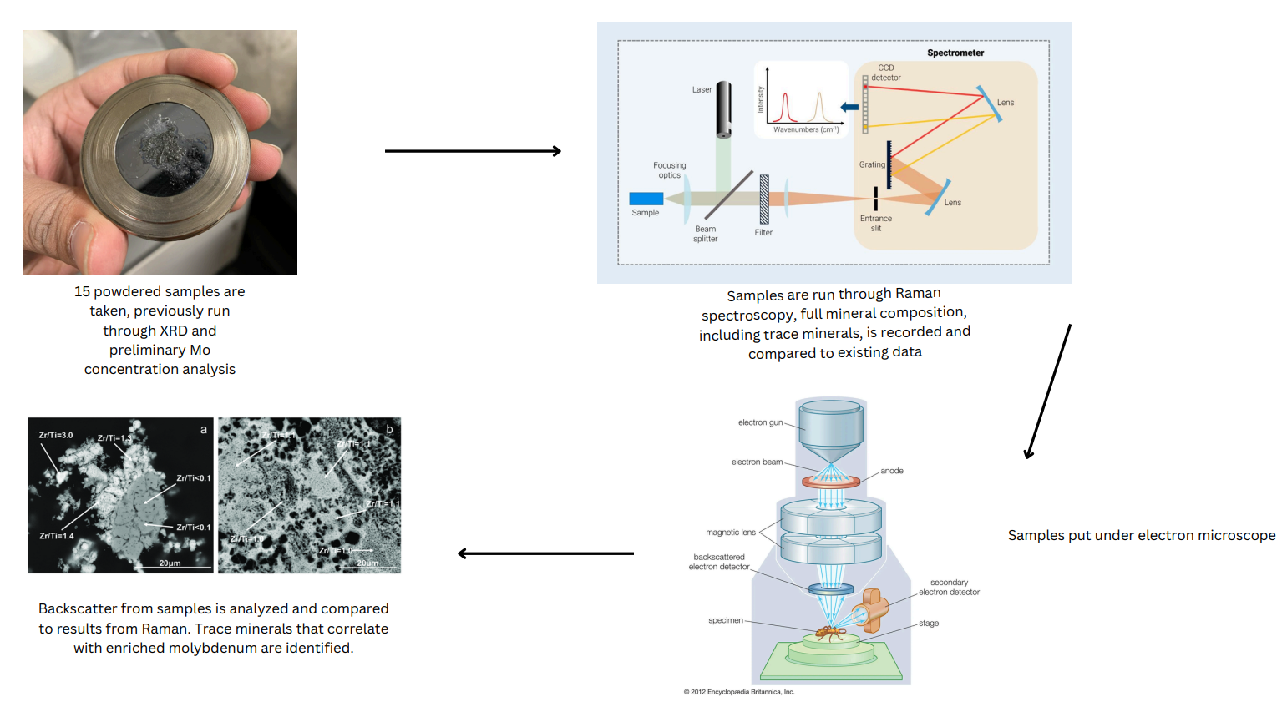
Proposed future research

Slide 7
Thank you!
Thanks to ASU/NASA Space Grant and Ariel Anbar for funding the project, Doug Daniels for training with the XRD machines, and special thanks to Ethan Edmans and Ariel Anbar for their continuous support and oversight.
Feel free to ask any questions about the presentation!
LinkedIn: www.linkedin.com/in/aseem-rajopadhye

